Slide 1
Rope wave
Precious makes a wave on a rope.
She moves her hand up and down quickly.
The wave moves forward along the rope.
wave

Slide 2
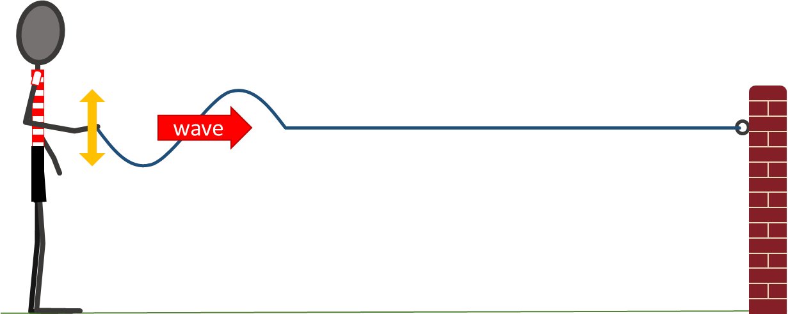
Rope wave
These statements are about the forces on the rope when the wave moves forward.
What do you think about each statement?
I am sure this is right
I think this is right
I think this is wrong
I am sure this is wrong
A
When Precious lifts the rope, the rope in front of her hand is pulled up.
B
When rope at the front of the wave lifts up, the rope just ahead of it is pulled up.
C
No forces are pushing forward on the rope.

